Slide 1
Statistical Estimation - Maximum Likelihood Estimator (MLE)

Slide 2
Statistical estimation
Statistical estimation is the process of using a sample of data to make an "educated guess" about a characteristic (a parameter) of a much larger group, known as a population.
It involves applying statistical rules called estimators to observed data to calculate
  Point estimates (a single value, like the sample mean for the population mean) or
  Interval estimates (a range of values, like a confidence interval for the population mean).

Slide 3
Key terms
Population: The entire group of interest (e.g., all students in a school, all steel produced).
Parameter: A numerical characteristic of a population (e.g., the true mean height of all people).
Sample: A subset of the population from which data is collected.
Statistic: A numerical characteristic of a sample (e.g., the mean height of a sample of students).
Estimator: A rule or formula used to calculate an estimate from sample data (e.g., the sample mean is an estimator for the population mean).
Estimate: The single computed value produced by an estimator.

Slide 4
Example: Estimating a Population Parameter
Goal: average height of all students in a college (unknown parameter).
Action: measure the height of all students in a class and compute the average (statistic).
Use the class average as an estimate of all student’s true average.

Slide 5
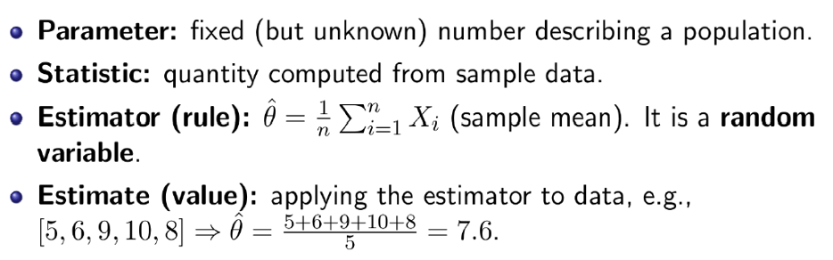
Parameter vs. Statistic & Estimator vs. Estimate

Slide 6
Why Estimation Matters in Al and Data Science
Models in ML Al have unknown parameters (e.g., mean/variance of a Gaussian).
We need estimators to: train models, predict outcomes, and quantify uncertainty.
This motivates systematic methods like Maximum Likelihood Estimation (MLE)

Slide 7
Likelihood Estimate
Likelihood estimation is a statistical method to estimate the parameters of a statistical model by finding the parameters that maximize the likelihood function, which is the probability of observing the given data under the assumed model.
This technique, known as Maximum Likelihood Estimation (MLE), finds the parameter values (maximum likelihood estimates) that make the observed data most probable, providing the best "fit" for the data within the assumed model.

Slide 8
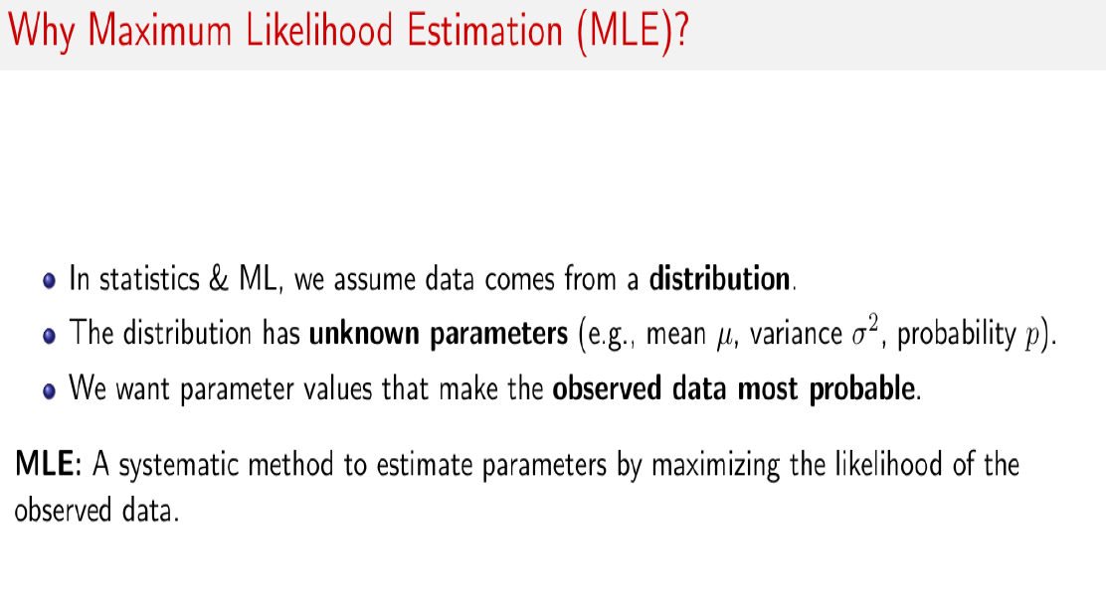

Slide 9
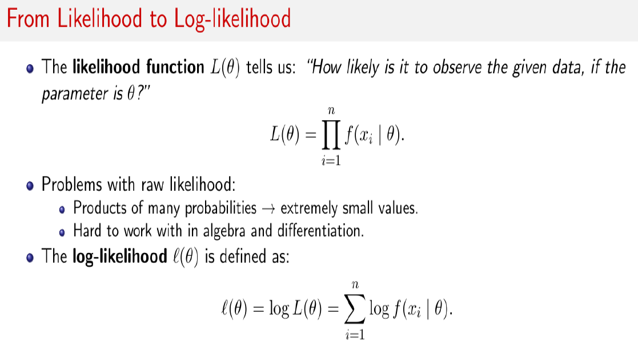

Slide 10
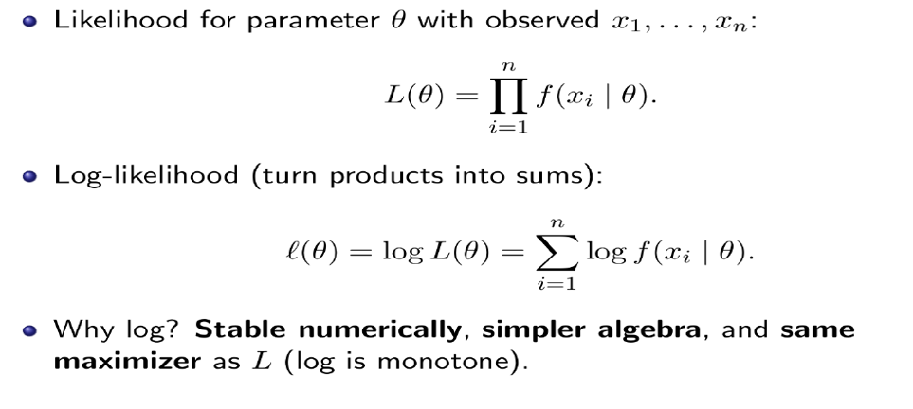
Log-likelihood function

Slide 11
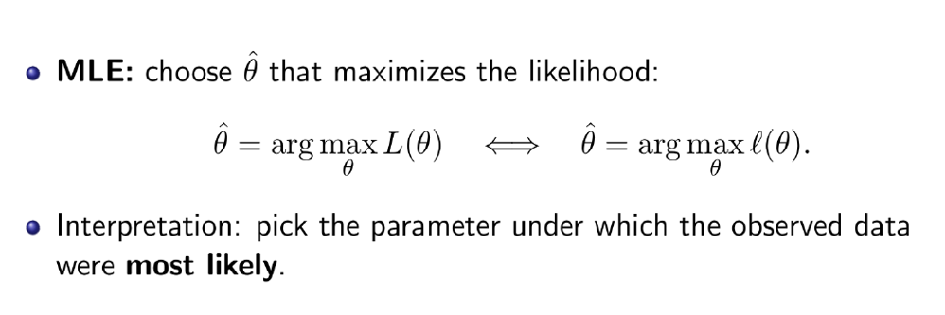

Slide 12
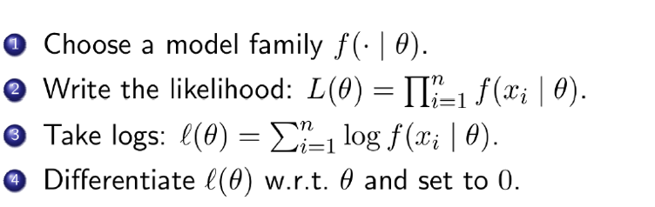
Steps for calculating Maximum Likelihood Estimate(MLE)

Slide 13
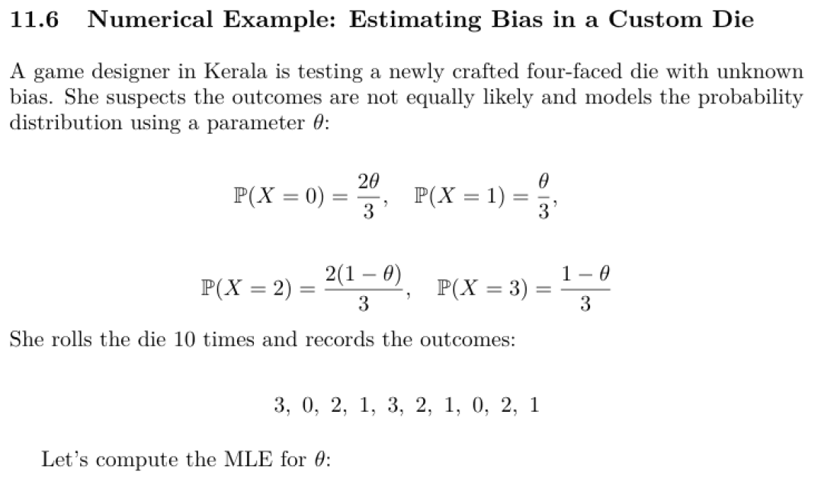

Slide 14
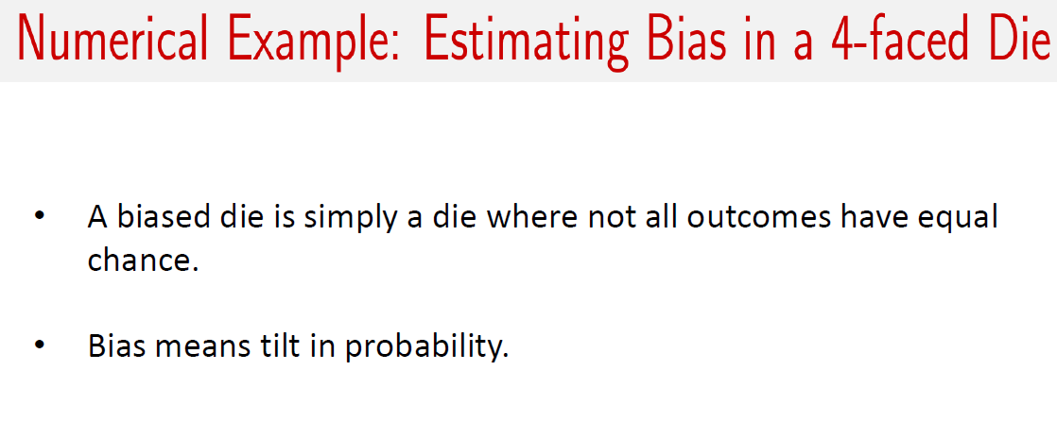

Slide 15
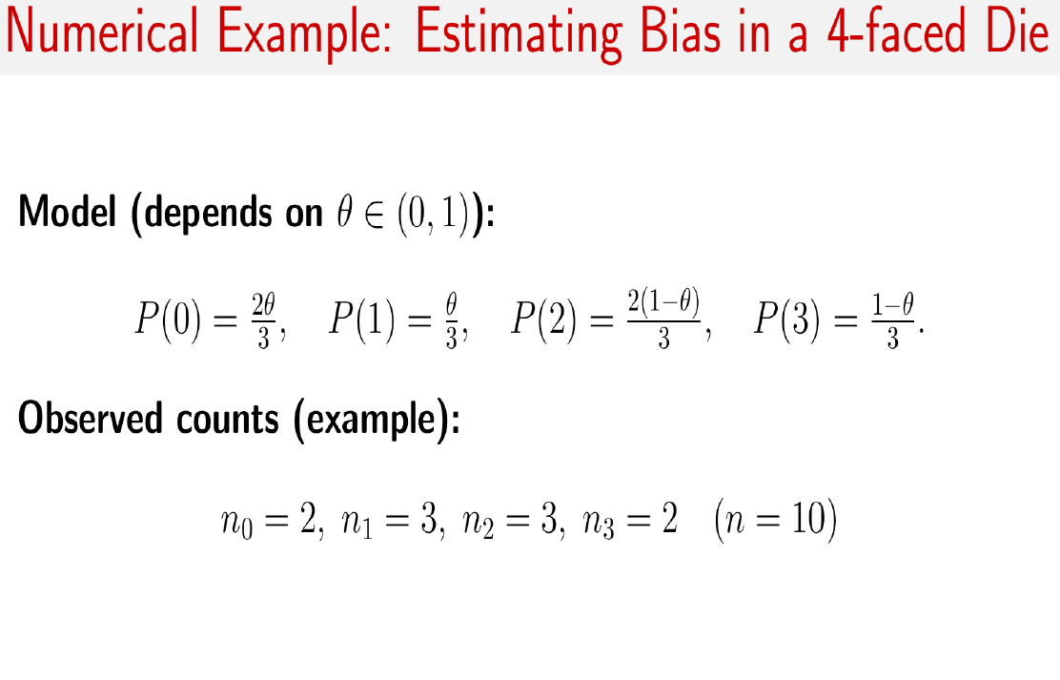

Slide 16

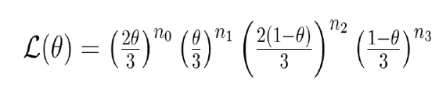


Slide 17
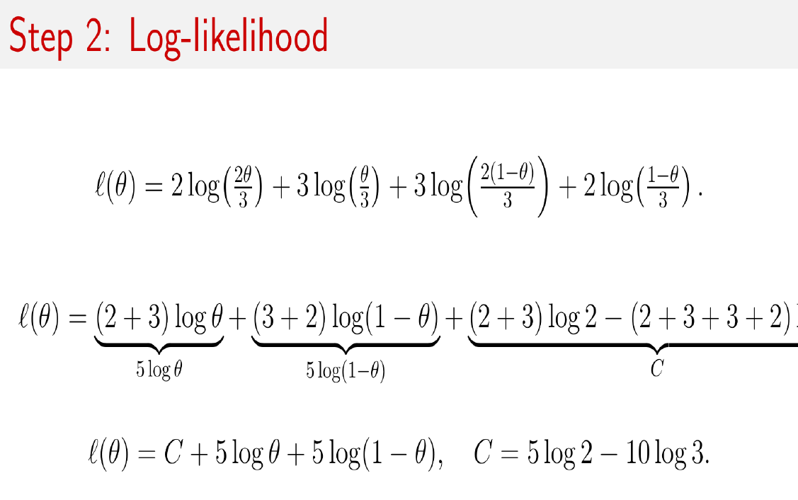

Slide 18
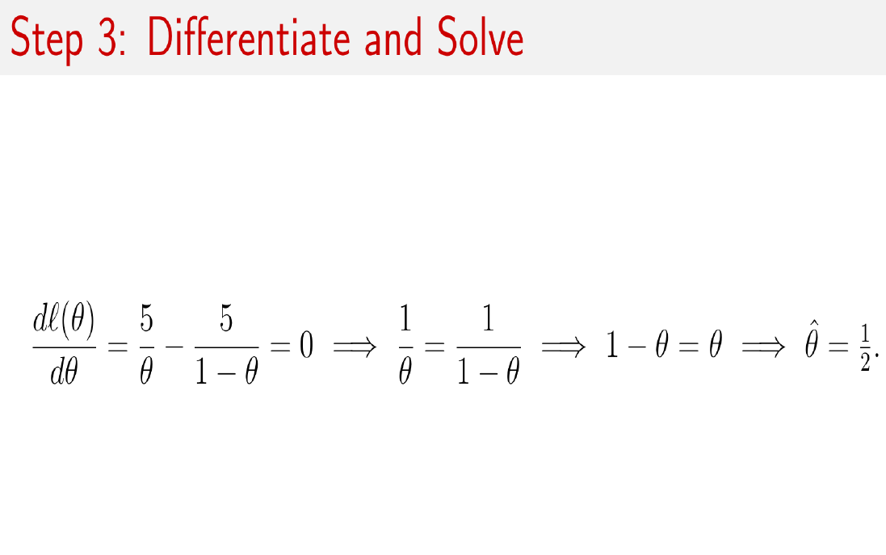

Slide 19
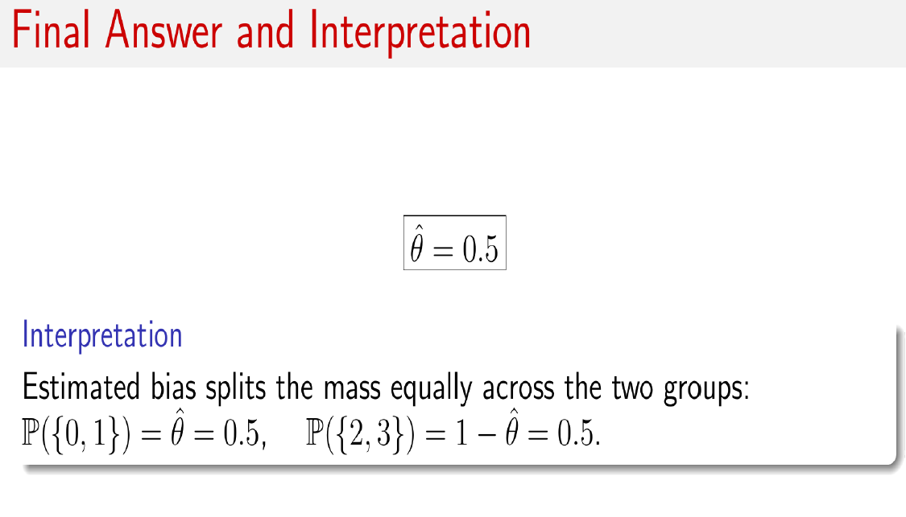

Slide 20
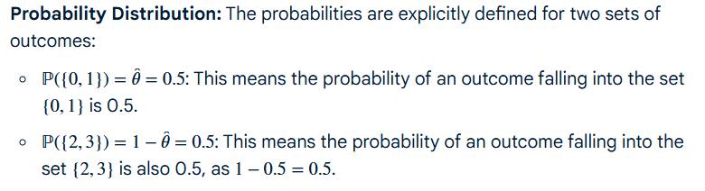

Slide 21
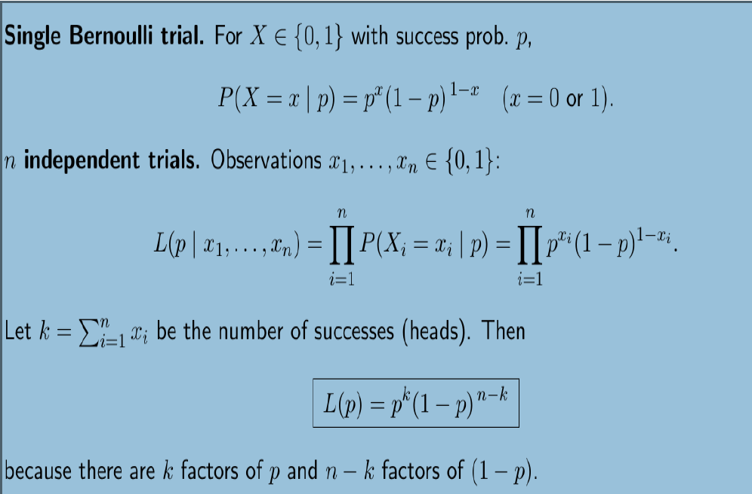
MLE for Bernoulli distribution

Slide 22
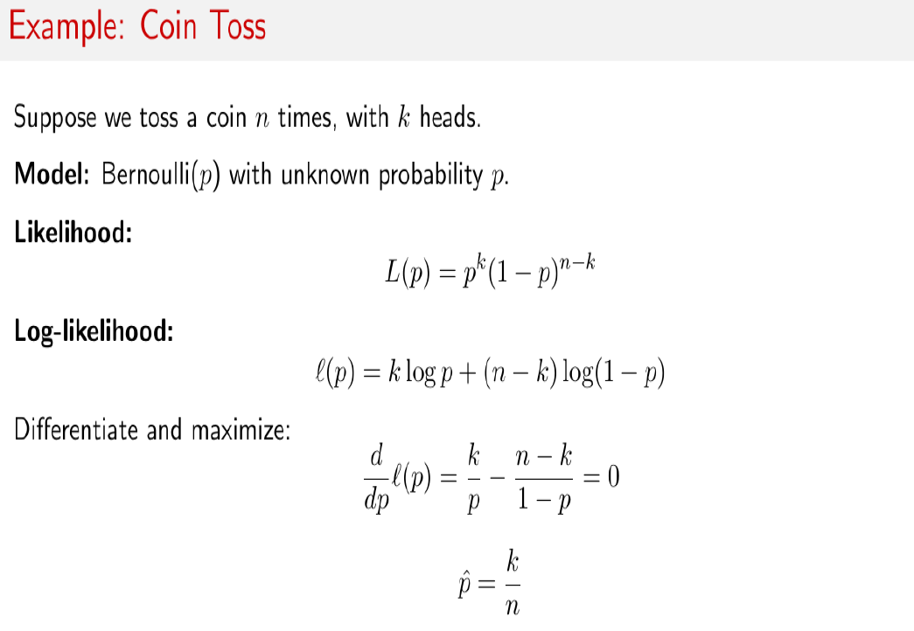

Slide 23
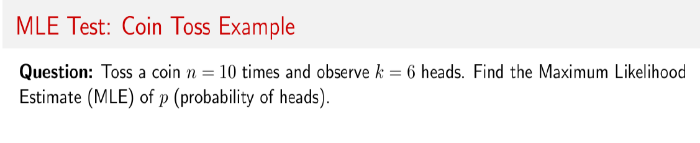
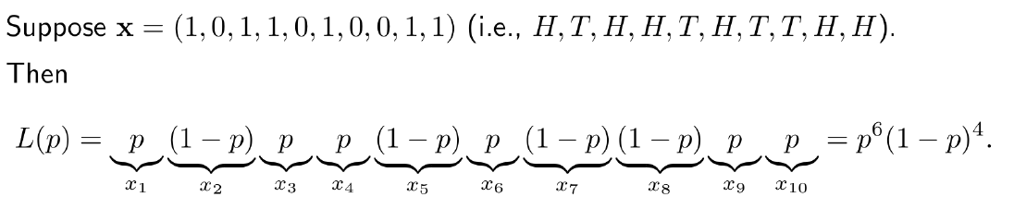
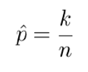

Slide 24
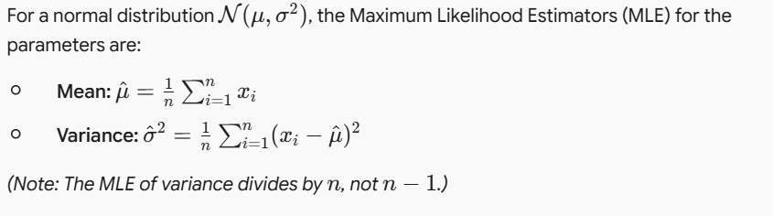
Apply MLE to estimate parameters of a normal distribution given the sample:
Data: [2.1, 2.3, 1.8, 2.5, 2.0, 2.2, 1.9, 2.4]
Find the estimates for mean and variance.

Slide 25
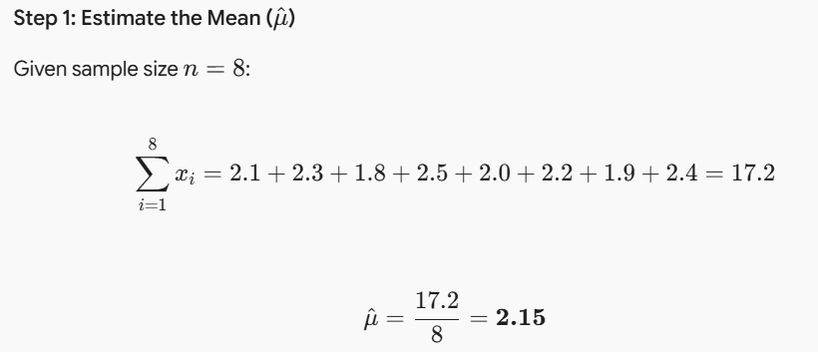

Slide 26
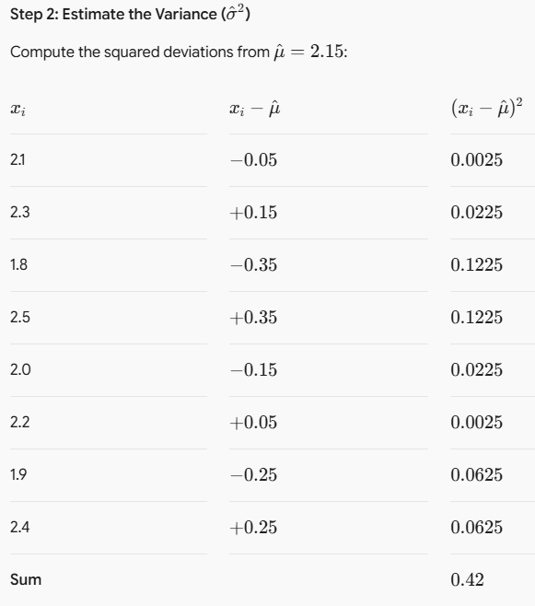

Slide 27
